Slide 1
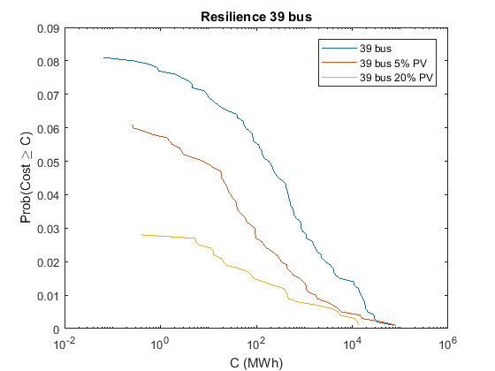
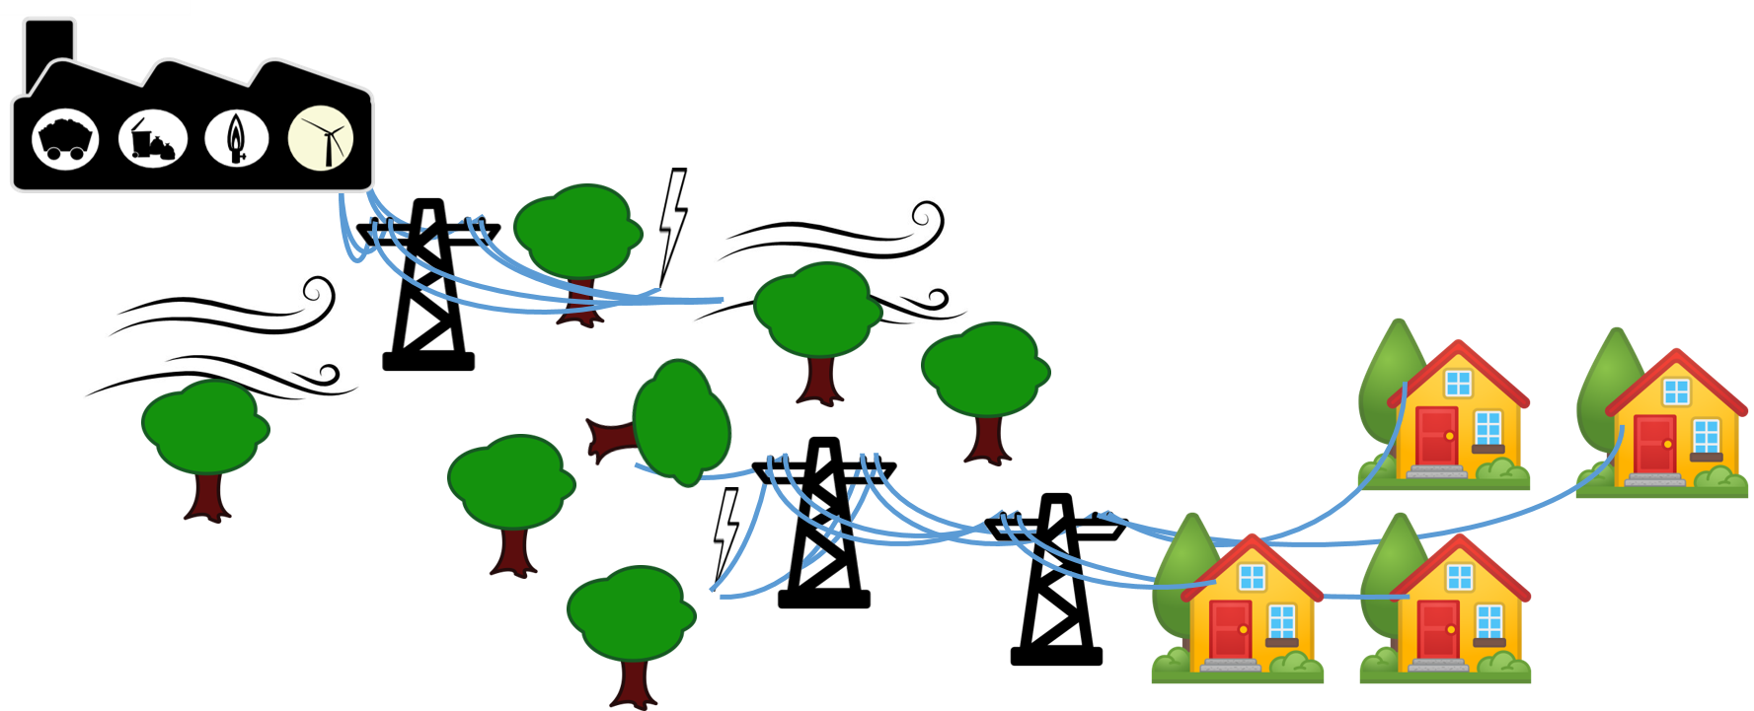
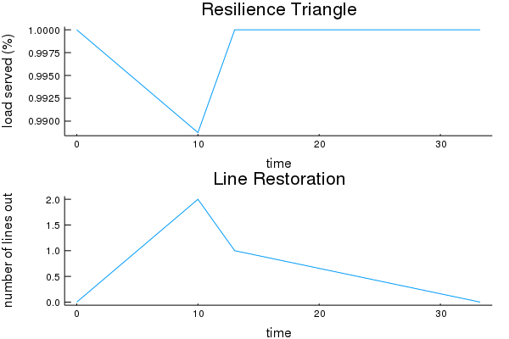
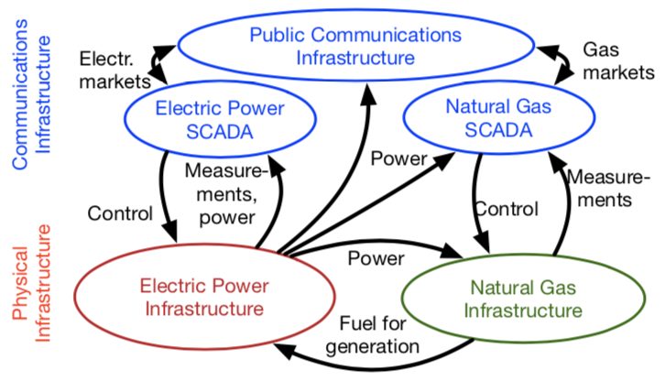
Measuring Power System Resilience Based on Empirical Data
Molly Rose Kelly-Gorham, Paul Hines, Ian Dobson (Iowa State University)
Abstract
Measuring Resilience of Power Systems
Preliminary Results
This work provides a new integrated approach to quantify resilience in electric power transmission networks and demonstrates the approach by measuring the impact of potential improvements to a power system. A novel aspect is the use of empirical data to develop the probability distributions of the number of line outages and the line restoration times that drive the model. Research on power system resilience is motivated by climate change, which increases the severity of large storms, and concerns about potential attacks on the electricity infrastructure. A key first step is to quantify the overall resilience of a particular power system.
Event
Resilience Distributions
Integrating unserved demand over time (lost energy) provides a measure of the resilience for a power system to a single event. A distribution of many potential events leads to a distribution of energy losses and is a measure of the resilience of the power system.
Restore
Initial Outages
Cascade
Resilience
Robustness
Rapid Restoration
Redundancy
Resourcefulness
Measure
Empirically Based Model
Update
Fraction of Load Served
Use distributions of number of line outage and recovery time data from a large US utility [3,4] to initiate outages and find restoration times.
Find initial lost load with Load Shedding Optimal Power Flow
As lines are restored, find lost load with the Restoring Load Optimal Power Flow
Measure resilience
Repeat 1-4
Future Work
Background
Coupling power system, natural gas and communication system models
There is a broad existing literature which focuses on each individual stage of the resilience problem, such as component reliability, or cascading failures, or restoration, but there is not much previous work that analyzes all the stages of resilience together to quantify the overall resilience. Some comprehensive efforts have produced frameworks and metrics to measure resilience [1] and have estimated system resilience to certain hazards by applying a good measure of component outages into a resilience framework [2].
Number of Lines Down
time
References
M. Bruneau, S. E. Chang, R. T. Eguchi, G. C. Lee, T. D. ORourke, A. M. Reinhorn, M. Shinozuka, K. Tierney, W. A. Wallace, and D. von Winterfeldt, “A framework to quantitatively assess and enhance the seismic resilience of communities,” Earthquake Spectra , vol. 19, no. 4, pp. 733–752, 2003.
M. Panteli, C. Pickering, S. Wilkinson, R. Dawson, and P. Mancarella, “Power system resilience to extreme weather: Fragility modeling, probabilistic assessment, and adaption measures”, IEEE Transactions on Power Systems, vol. 32, no. 5, pp. 3747–3757, 2017.
S. Kancherla and I. Dobson, “Heavy-tailed transmission line restoration times observed in utility data,” IEEE Transactions on Power Systems, vol. 33, no. 1, pp. 1145–1147, 2018.
“BPA transmission services operations reliability,” Apr. 2017. [Online]. Available: https://transmission.bpa.gov/Business/Operations/Outages

